Slide 1


Bapuji Institute of Engineering and Technology
Department of Computer Science and Engineering
Davanagere-577004
Mini Project(BCS586) Presentation
On
BLOCKCHAIN BASED CERTIFICATE VERIFICATION SYSTEM
Team Associates
Name of the Student USN
Ankitha B 4BD22CS016
Shriya Dommeti 4BD22CS154
Rakshith O N 4BD23CS412
Guide
Dr Naseer R Ph.D
Associate Professor
Program Coordinator
Dr. Nirmala C R Ph.D
HoD of the Department
Mini Project Coordinator
Prof.Archana T Chawhan
Assistant Professor

Slide 2
CONTENTS
Abstract
Introduction
Literature survey
Problem Statement
Objectives
Design
Tools and Technologies
Implementation
Learning Outcomes
Results
Analysis of Results
Conclusion

Slide 3
ABSTRACT
The Blockchain-Based Certificate Verification System securely stores and verifies educational and professional credentials using blockchain technology. It ensures certificates can't be altered or faked by saving their hashes on a blockchain. This system allows for quick, reliable verification and reduces fraud, improving trust and efficiency in credential verification.

Slide 4
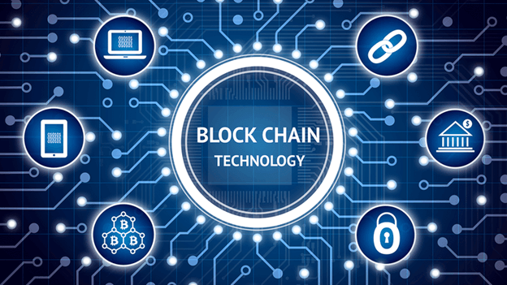
INTRODUCTION TO BLOCKCHAIN
Blockchain is a distributed ledger that records transactions in a chain of blocks that are linked together by cryptographic hashes.
Blockchain technology has many uses, including:
Cryptocurrencies
Data immutability
Cost-efficient transactions
Automated contract fulfillment
Supply chain management

Slide 5
KEY FEATURES OF BLOCKCHAIN
Decentalization
Immutability
Blockchain
Enhanced Security
Transparency

Slide 6
Continued..
The Blockchain-Based Certificate Verification System provides a secure, decentralized platform for managing and verifying educational certificates.
By utilizing blockchain technology, the system ensures data integrity, tamper-proof records, and efficient real-time verification.
This eliminates reliance on centralized authorities, reduces fraud, and enhances trust among issuers, holders, and verifiers.

Slide 7
LITERATURE SURVEY
Sl. No | Title | Published In | Author(s) | Methodology | Year | Gaps
1 | Blockchain Based Certificates in Professional Development and Skill Recognition | Journal of Blockchain Research and Development | Michael S. Robinson, Clara Hernandez | Smart contracts for automation, verifiable proof of skills and qualifications. | 2023 | Lack of infrastructure and standards.
2 | Blockchain Based Certificate Verification System Management | ATM | Qurotul Aini, Eka Purnama Harahap, Nuke Puji Lestari Santoso, Siti Nurindah Sari, Po Abas Sunarya . | Certificate Structure Extension, Performance Evaluation, Comparison with Existing Methods. | 2022 | Scalability, Privacy and Data Security, Network Latency and Real-Time Response, Integration with Existing Systems.
3 | Blockchain Based Academic Certificate Verification System | Springer | Shivani Pathak, Vimal Gupta, Nitima Malsa, Ankush Ghosh, and R.N. Shaw. | Blockchain's decentralized nature and immutability to prevent fraud and streamline the verification process. | 2022 | The paper does not thoroughly address how blockchain technology will interact with other systems.

Slide 8
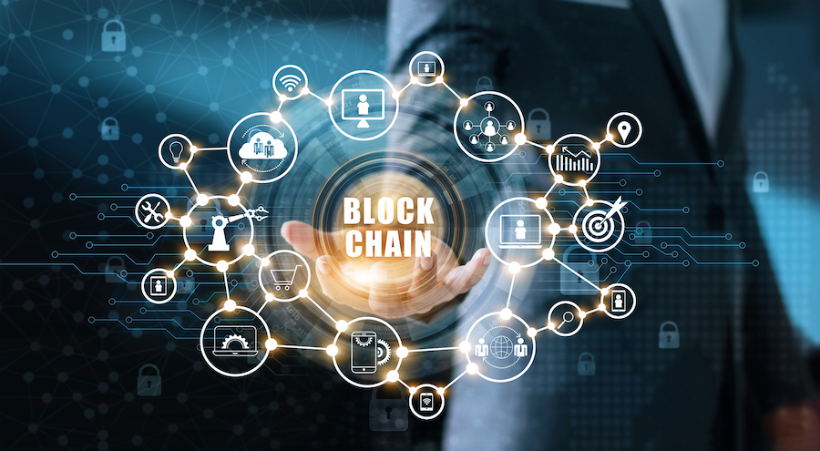
PROBLEM STATEMENT
The traditional way of verifying educational and professional certificates is slow and easy to tamper with, causing fraud and delays. This creates extra work for schools, employers, and individuals.
SOLUTION:
We need a digital solution for secure, transparent, and efficient verification. Blockchain can provide unchangeable records, reducing fraud and improving efficiency.

Slide 9
OBJECTIVES
To design and develop user interface for certificate holders, issuers, and verifiers .Enable easy input of certificate details during issuance.
To develop and handle certificate data and verifications on the blockchain using the smart contract.
To test and deploy the certificate verification system on the virtual blockchain platform.

Slide 10
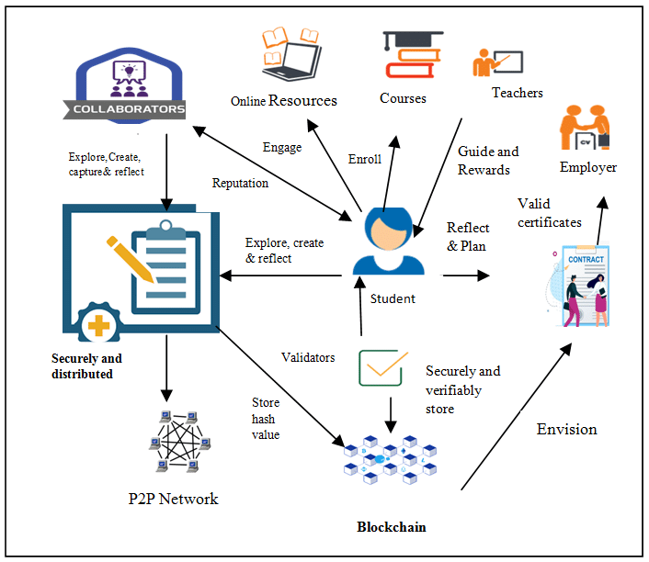
DESIGN
Fig : System Architecture

Slide 11
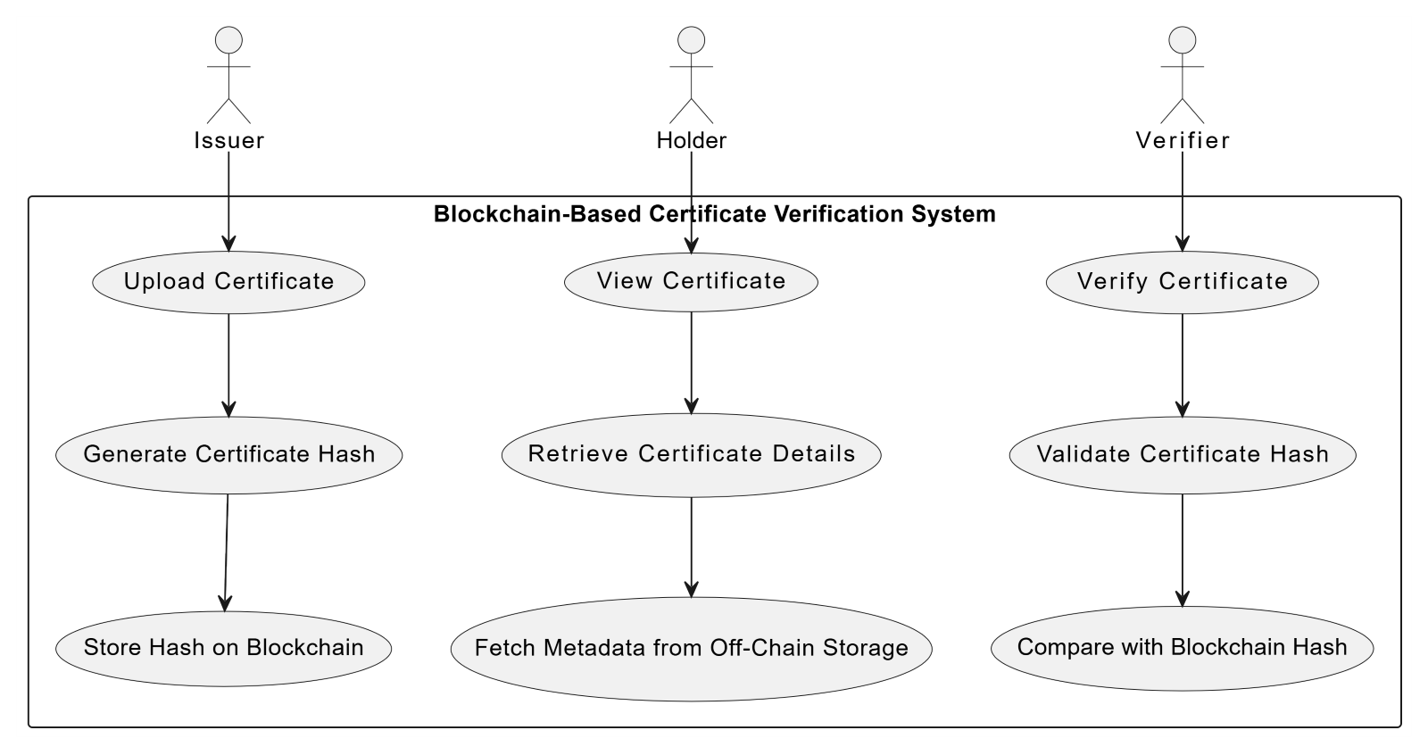
Fig: Use Case Diagram

Slide 12
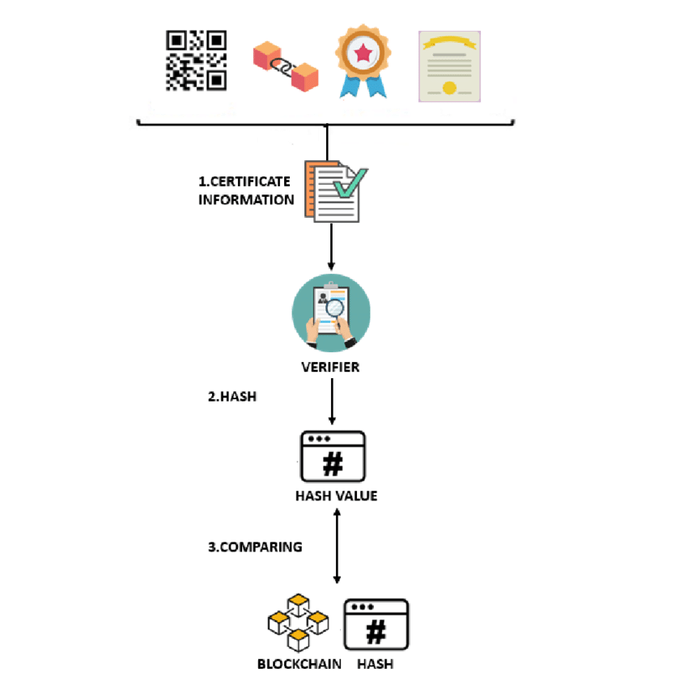
Fig : Flow Diagram

Slide 13
TOOLS AND TECHNOLOGIES
Blockchain Platform:
Ethereum
Smart Contract Development:
Solidity
Front-End Development:
HTML/CSS
JavaScript
React.js
Back-End Development:
Node.js
Blockchain Interaction:
Web3.js

Slide 14

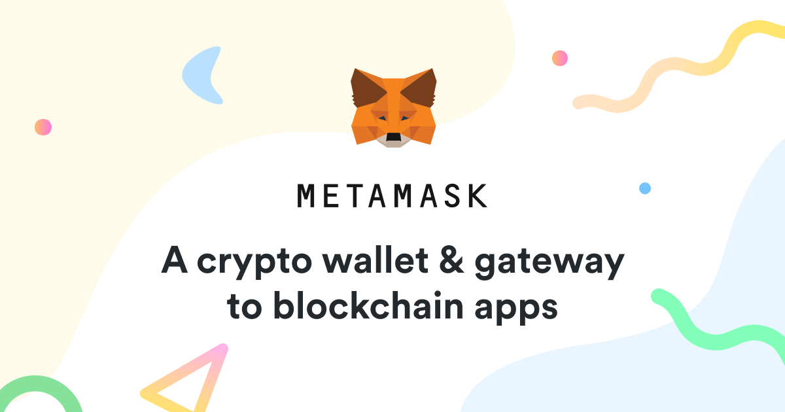
Development and Testing Tools:
Ganache is a personal Blockchain for Ethereum development that can be used for testing smart contracts and DApps in a sandbox environment.
MetaMask is a cryptocurrency wallet that allows users to interact with the Ethereum blockchain and other blockchains. It can be accessed through a browser extension or mobile app.

Slide 15
IMPLEMENTATION
contract CertificateContract {
// Event declaration to log certificate creation
event CertificateWrite(
address indexed issuedBy,
address indexed issuedTo,
string indexed id,
Certificate certificate;
);
// Define a structure for storing certificate details
struct Certificate {
string id;
string createdAt;
string expireAt;
address issuedBy;
address issuedTo;
string data;
}

Slide 16
// Mapping to store certificates by their unique IDs
mapping(string => Certificate) public certificates;
// Function to create a new certificate
function create(
string memory id,
string memory data,
address issuedTo,
string memory expireAt,
string memory createdAt
) public {
Certificate memory c;
c.createdAt = createdAt;
c.expireAt = expireAt;
c.issuedTo = issuedTo;
c.issuedBy = msg.sender;
c.data = data;
c.id = id;
certificates[id] = c; //Store the certificate in the mapping
emit CertificateWrite(msg.sender, issuedTo, id, c);
// Emit an event to log the certificate creation
}
}

Slide 17
LEARNING OUTCOMES
Understanding Blockchain Technology:
Smart Contract Development:
Data Security Practices:
Global Reach:

Slide 18
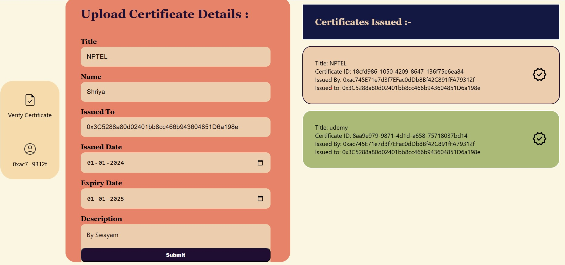
RESULTS
Fig1:Upload Certificate Details

Slide 19
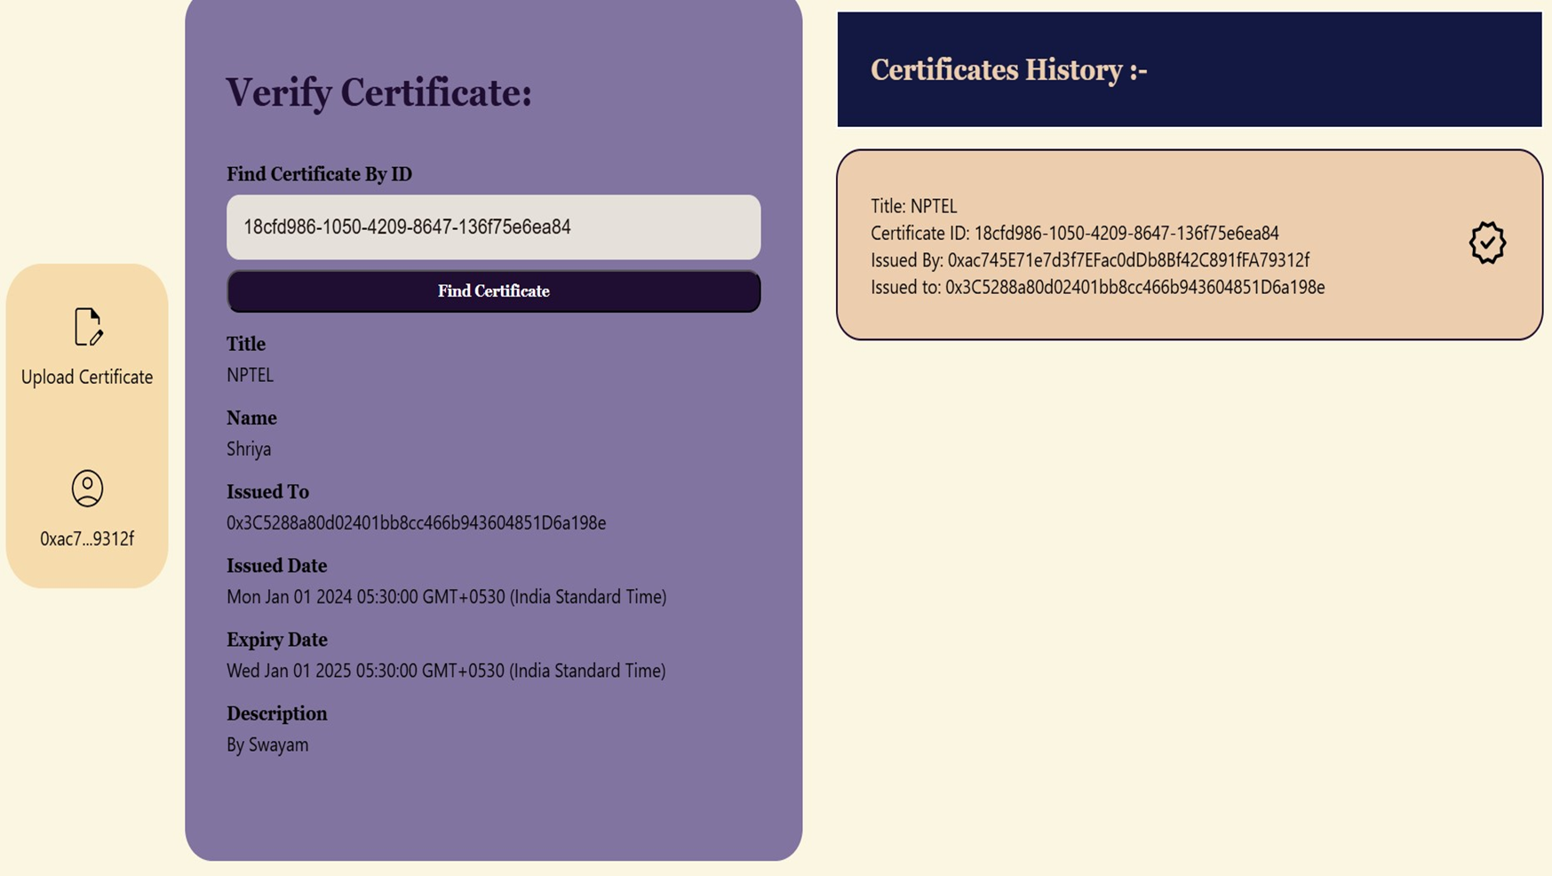
Fig2:Verify Certificate

Slide 20
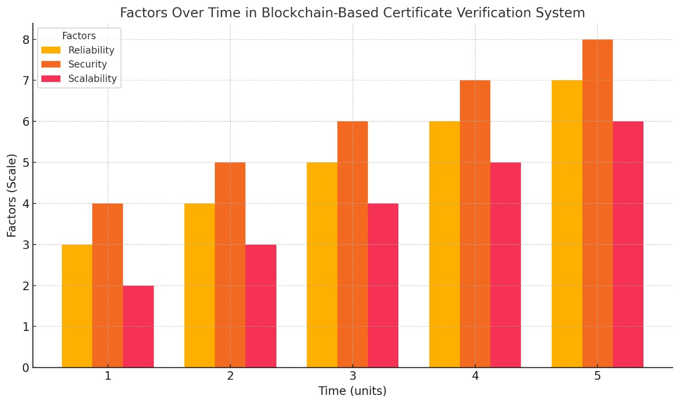
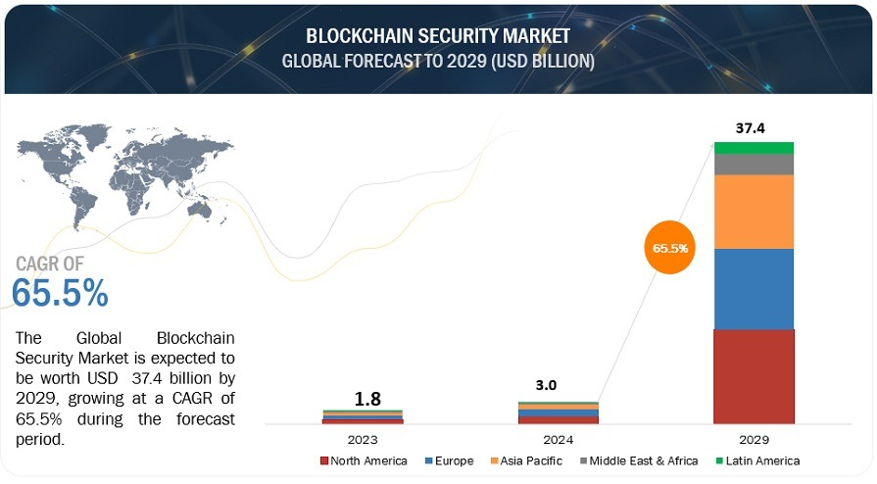
ANALYSIS OF RESULTS

Slide 21
CONCLUSION
Enhanced Security and Trust: The system leverages blockchain's decentralization, immutability, and transparency to eliminate risks of fraud, forgery, and credential loss, ensuring reliable verification processes.
Efficient and Streamlined Process: It provides a seamless, tamper-proof method for managing and verifying certificates, reducing time, cost, and administrative efforts.
Catalyst for Digital Transformation: The project underscores blockchain's transformative role in modernizing the education and professional sectors, promoting innovation and digitalization.
Foundation for a Trustworthy Ecosystem: By addressing current challenges, the system establishes a scalable and accessible digital credentialing framework for the future.

Slide 22
THANK YOU

